Slide 1
QR CODE BASED ATTENDANCE SYSTEM
TEAM MEMBERS |  | HT.NO
P.SAI THARUN |  | (19S41A0572)
SD.NAMAAN QADRI |  | (19S41A0587)
MD.RIYAZ |  | (19S41A0554)
M.KUSHALKUMAR |  | (19S45A0562)
Under The Guidance of
Mrs.A.SOUJANYA
Assistant professor

Slide 2
Introduction
In this era of technology smartphones play a significant role in our day to day life. Nowadays smartphones can solve most of the problem very quickly and easily. It has made life of every person simple and easier with different social app, commercial app, problem solving app, app for education and marketing etc.
Followed by the technology the paper purposed a system that will handle a problem for recording the attendance.
The proposed system is a couple of two applications, one for generating the QR Code by entering the student details and second application for taking the attendance and generating the attendance in CSV or XLS format.

Slide 3
Advantages:
This system decreases the human effort of manually taking attendance of every student.
There is very least possibility for proxies to occur.
In this “NO-CONTACT” period, this system can be used as an alternative to the biometric attendance system.
Disadvantages:
The accuracy of the data collected is the biggest issue in old system.
Proxy or other ways are easily possible.
Identity can’t be manipulated

Slide 4
System Requirements
Software Requirements:
Operating system : Windows 7/10
Language : python 3.4.7,Pycharm
Domain : Machine Learning
Alogrithms : Cascade , CNN
Hardware Requirements:
Processor : intel® core(TM) i5
CPU : 1.60 GHz 1.80GHz
Ram : 4GB
Hard disk : 10GB

Slide 5
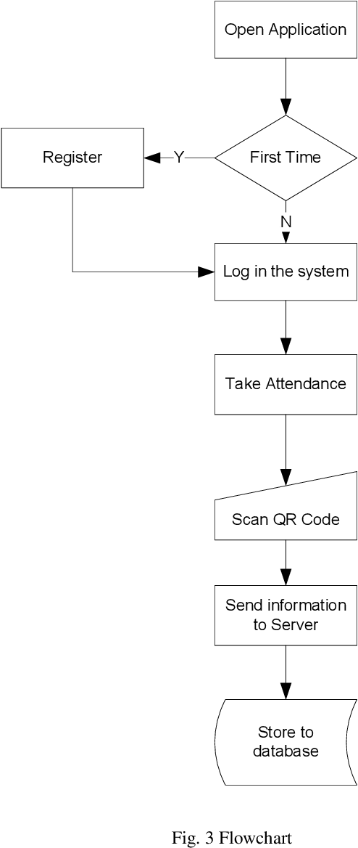
Design
System Architecture:

Slide 6
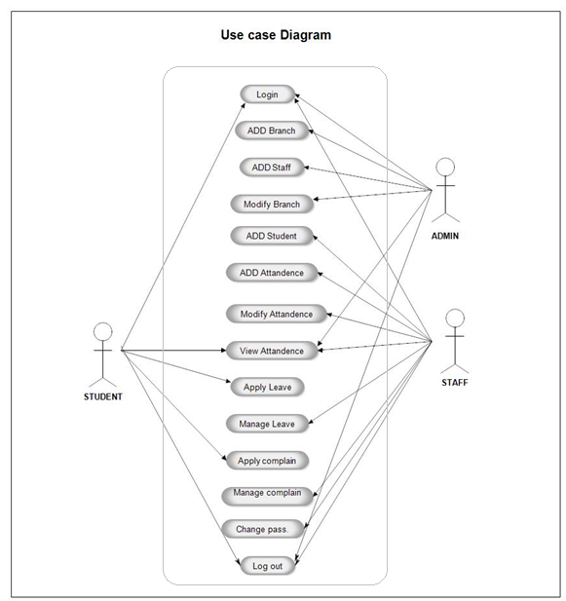
Use case diagram:

Slide 7
Modules
DATABASE CREATION
TRAINING OF QR
QR DETECTION
OR RECOGNITION

Slide 8
Working
First we create a project in the PyCharm IDLE.
Store a few images of students in the database.
Type and execute the correct source code.
Error-free code runs and the camera opens on the laptop.
Now it detects the faces of students who stand in front of the camera according to the images stored in the database earlier.
The attendance also gets saved in a CSV file.

Slide 9
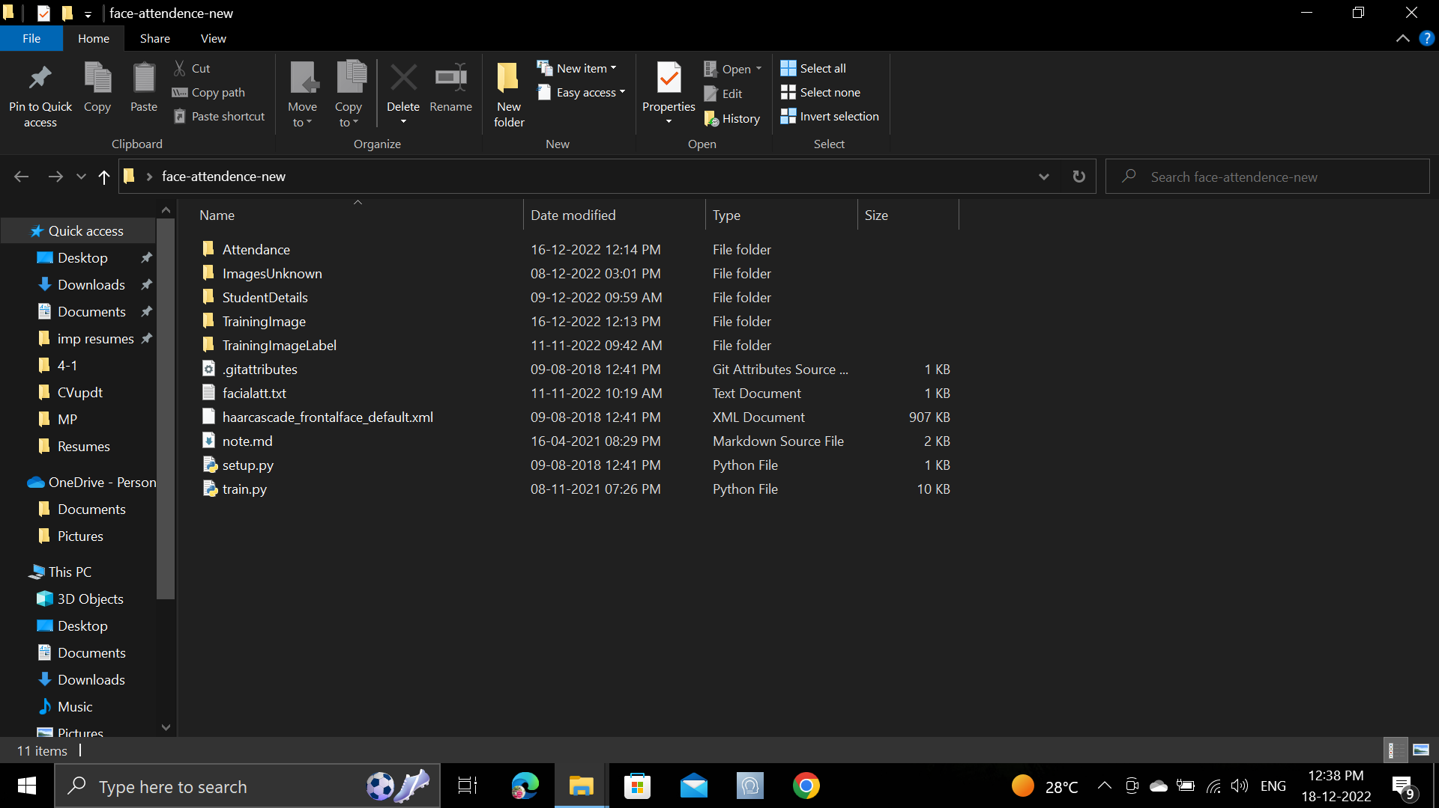
RESULTS
Open file Location

Slide 10
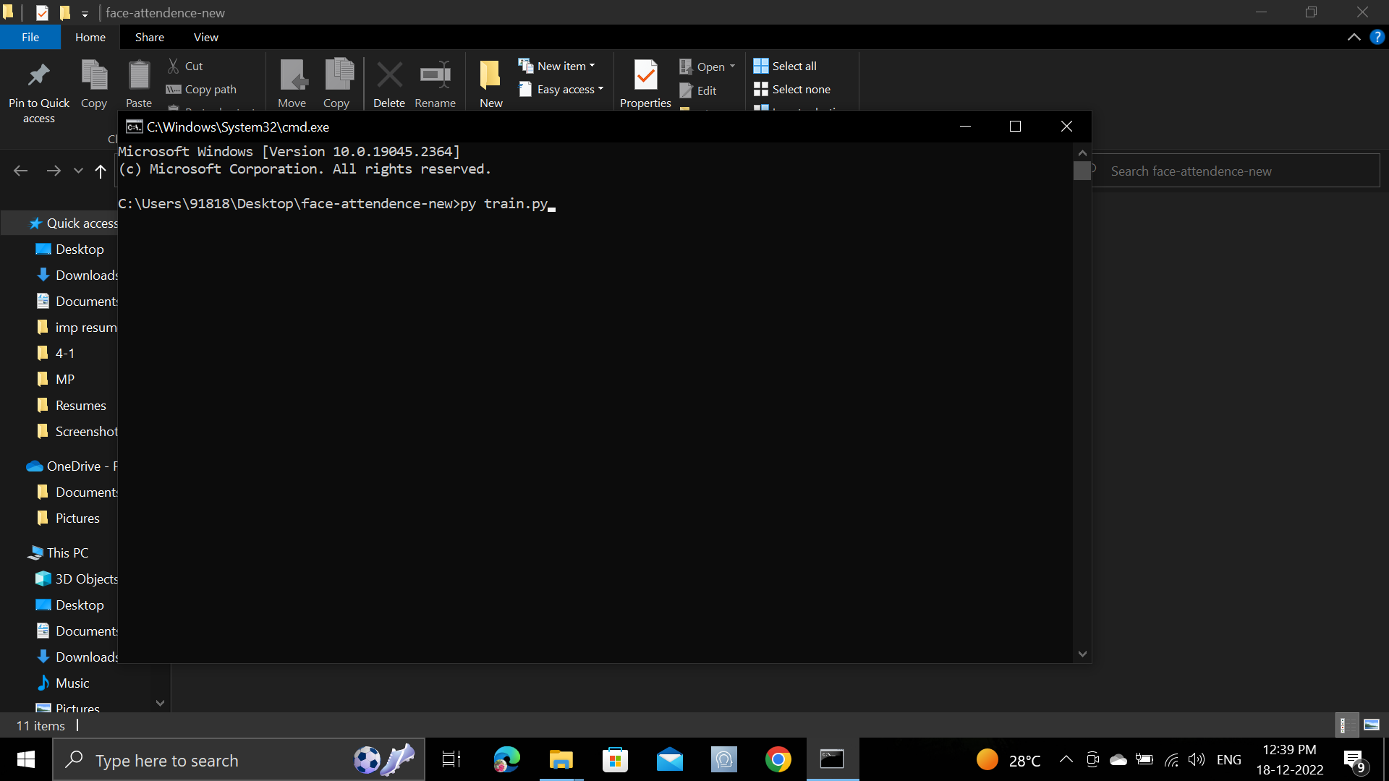
Open Cmd to move homepage

Slide 11
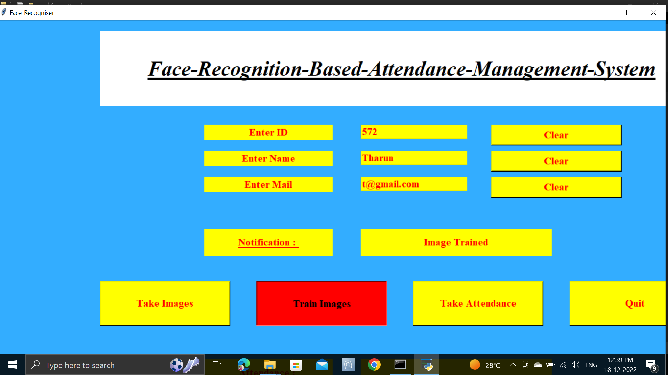
Enter Details and Train the data

Slide 12
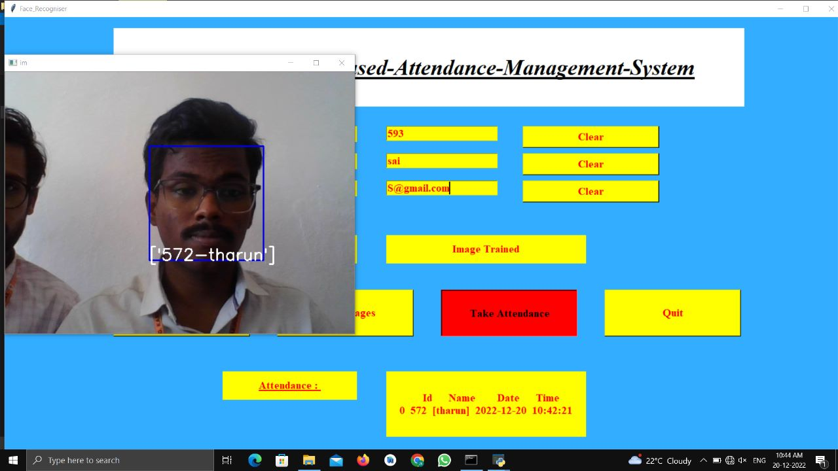
Attendance Marked

Slide 13
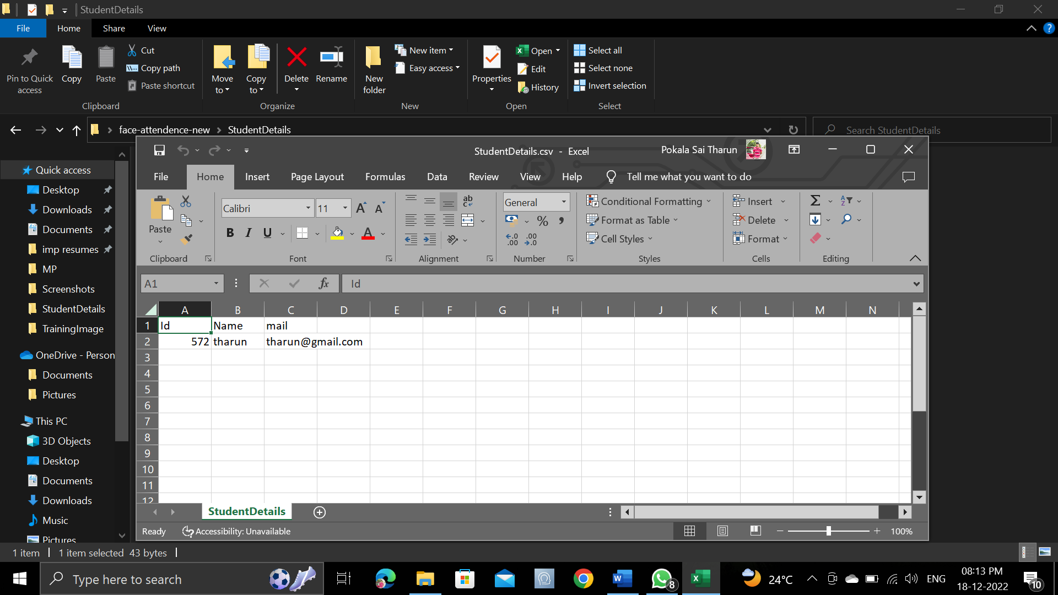
Check Attendance whether markerd or not using csv File

Slide 14
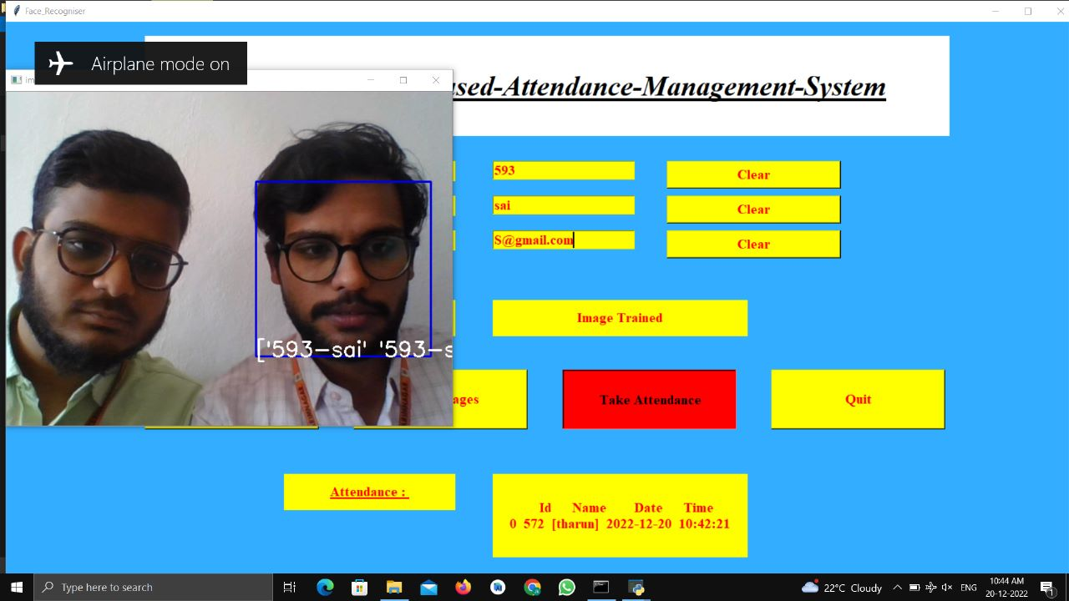
Check Using Multiple data

Slide 15
Conclusion
From our experiment, we noticed the face recognition was sensitive to face background, light, and head orientations. This technique described the accurate and efficient method of automatic attendance in the classroom which could replace the traditional method. An automatic attendance has many advantages, most of the existing systems are time consuming and require semi manual interference from lecturers, our system seeks to solve these issues by using face recognition in the process to save the time and labor.
Automatic attendance system can be improved by increasing the number of features which can be extracted to increase accuracy of face recognition. Once the software is developed and tested properly, it could be improved to cover full institutions such as the faculty of engineering

Slide 16
References
[1] M. Ahmed, S. Spagna, F. Huici, and S. Niccolini. A peek into the future:
Predicting the evolution of popularity in user generated content. In
Proceedings of the Sixth ACM International Conference on Web Search
and Data Mining, WSDM ’13, pages 607–616, New York, NY, USA,
2013. ACM.
[2] P. Bao. Modeling and predicting popularity dynamics via an influencebased
self-excited hawkes process. In Proceedings of the 25th ACM
International on Conference on Information and Knowledge Management,
CIKM ’16, pages 1897–1900, New York, NY, USA, 2016. ACM.
[3] M. Cha, H. Kwak, P. Rodriguez, Y.-Y. Ahn, and S. Moon. Analyzing
the video popularity characteristics of large-scale user generated content
systems. IEEE/ACM Trans. Netw., 17(5):1357–1370, Oct. 2009.

Slide 17
Thank you

